Slide 1

Manhattan
Real Estate
Tool

Slide 2



Team Members
Mehar Chaturvedi
Isha Angadi
Sandeep Pvn

Slide 3


Elevate your
real estate
strategy with our
data-driven platform!
Notes:
Data mapping is an important tool in real estate because it allows professionals to visualize and analyze spatial data in a way that is meaningful and useful. A real estate professional can use this tool to assess the desirability of a particular property not just based on sale price but on several factors like neighborhood, building class categories, and tax categories. Using this tool, a real estate professional can recommend properties to their clients powered by data!

Slide 4
Manhattan Real Estate Tool
PropTech data-driven tool for real-estate agents.
Efficiently guide clients in finding residential properties
Catered to client’s requirements and preferences
Interactive and user-friendly data visualization tool.
Notes:
PropTech can assist with market analysis, allowing agents to better understand local real estate trends, and with client prefences, helping agents to identify the types of properties and neighborhoods that are most likely to appeal to their target client base.

Slide 5
Overview
DATA CLEANING
DATA ANALYSIS
DATA MODELING
R SHINY APPLICATION

Slide 6
DATA CLEANING
Notes:
The goal of data cleaning is to ensure that the data is accurate, consistent, and ready for analysis.

Slide 7
Process
Add longitude and latitude using GeoCoding API
Remove irrelevant columns
Example: Easement, Apartment Number
Remove duplicate rows
Handle data types
Example: Neighborhood
Character type → factor.type
Data: NYC Manhattan Rolling Sale (December 2021 - November 2022)
Notes:
The following steps were taken to clean the Rolling Manhattan Dataset:
Using geocoding APIs, longitude and latitude were added.
Irrelevant columns such as borough easement were removed.
Detect and remove duplicate rows
Convert columns to the appropriate types (eg: 'neighborhood' from character to factor type)
Rolling manhattan – remove rows manually
Add longitude and latitude slide - named data.csv (22435 rows, 23 variables) (geocoding api)
Removing 7 columns – borough, easement, apartment number, address, zip code, block, lot
285 duplicate rows
Conversion to factors
Neighborhood, build class category, tax class at present, building class at present, tax class at time of sale, building class at time of sale
Conversion to numeric
Longitude, latitude, sale price
Conversion to date
Sale date
Remove zeros in sale price (transfer of ownership)
The first step that removed columns with more than 60% missing rate
Data og — if columns with < 10% of missing values then we drop the rows as well (16448 rows, 11 columns)
Data sqrft — % of missing values is # less than 4%, we simply remove them (783, 16 columns)
Data units — Sum of commercial and resident need to be 1 (1828, 14 columns)
Land sqft is dropped
with less than 17%, we simply remove the rows
more than 80% of rows have missing values for columns— land square feet and # gross square feet. we remove the columns
Outliers calculation 0.7% giving us $2510, was calculated manually
Can be automated and changed
At 0.65% we got 16.3 – we wanted to keep multiple of 5

Slide 8
Process
Handle Missing Values
Columns with more than 60% missing rate were removed.
Detect and remove outliers (occurring as mistakes)
Property with relatively low sale price
Commercial units with negative values
Cleaned data frame
Notes:
Land area, residential units and sale price
Check for outliers as mistakes and remove them (properties with 0 sale price, commercial units with negative values).
Detect and remove outliers (occurring as mistakes)
Property with relatively low sale price
Commercial units with negative values
Cleaned data frame

Slide 9
Data Description
Attribute | Description
Neighborhood | Neighborhood within Manhattan
Building Class Category | Identify similar properties grouped by building class
Tax Class at present | Tax class assigned by use of property (Class 1,2,3,4)
Building Class at present | Class assigned by constructive use of property
Tax Class at time of sale | Tax class assigned during sale of property
Building Class at time of sale | Building class assigned during sale of property
Longitude | Property Longitude calculated using google API
Latitude | Property Latitude calculated by google API
Sale Price | Price paid for the property
Sale Date | Date property was sold
Notes:
As you can see most of these attributes are self explanatory — let me bring your attention to building class and tax class. Building class is used to identify similar properties. For example,one-, two-, and three-family homes
The tax class denotes one of four classes. For example, the one-, two-, and three-family homes previously mentioned would fall under tax category one

Slide 10
DATA ANALYSIS

Slide 11
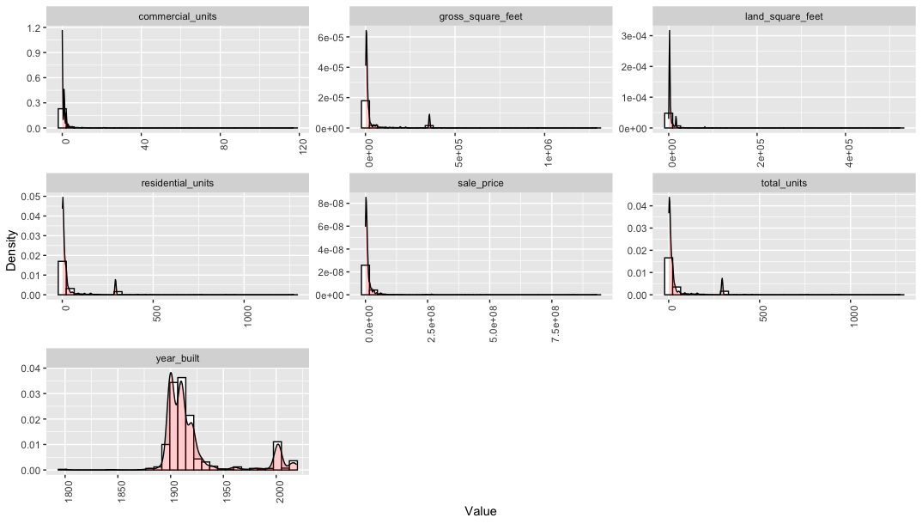
Figure: Numerical Features Data Distribution (Before Log Transformation)
Notes:
All right skewed - anticipated except for years (well made buildings)
To comment more we go to data distribution after log transformation

Slide 12
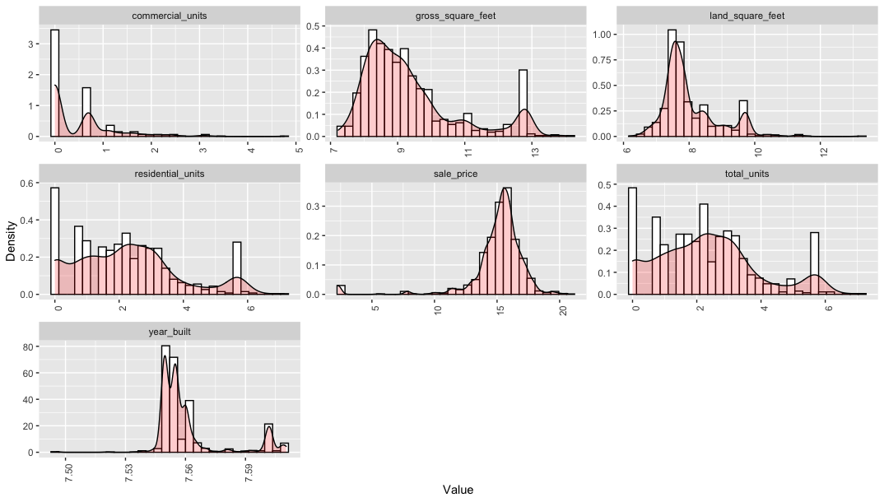
Figure: Numerical Features Data Distribution (After Log Transformation)
Notes:
After Log
Sale price - distribution is fairly normal, high mean-> corroborates with manhattan being an expensive place!
Similar distribution for residential units and total units -> if the property has residential unit, ratio of residential to commercial unit is very high

Slide 13
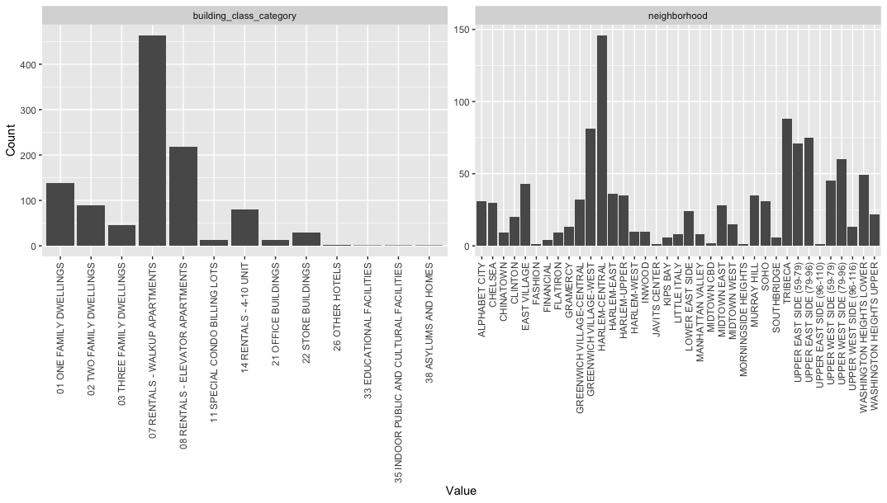
Figure: Categorical Features Data Distribution
Notes:
Building class category : lot of rental apartments were sold
Post covid comeback triggered the demand for rental apartments, catering to uncertainty of
good source of investment for rental property
Neighborhood wheeresold the maximum amount of properties
Harlem central close proximity to popular neighborhoods in upper manhattan and upper west side – very accessible while being cheaper than those neighborhoods
Tribeca - office space, count is high
Upper east side - in demand (amenities luxury)- count is high

Slide 14
DATA
MODELING

Slide 15
Data Processing
Filter residential properties
Generate features
Gross square feet per total unit
Age of the property (sale date - year built)
Notes:
As a real estate agent focusing on residential units, it is essential that the clustering being performed is on residential units. The procedure begins with
Filtering out only residential properties in interest of catering to real estate agents
Two additional columns are introduced focusing on the age and the gross square feet per unit of each property

Slide 16
Data Processing
Data Scaling for numerical columns
Robust Scaling - handle outliers (extreme values) by using median and IQR
Performance comparison with log normalization followed by robust scaling
Notes:
Data standardization and normalization
Standardize the data using robust standardization using RobScale
Aids in dealing with outliers in the data (can add previous k-means graph with outliers)
Normalize the standardized data using log transformation??

Slide 17
K-means Clustering
Comparing k-means performance on n clusters, where n = 1, 2, ..., 15
Metric: Within Sum of Squares (WSS) cluster distance
Detect Elbow point — WSS against k plot
Notes:
Perform unsupervised learning technique of k-means clustering used to group data into clusters based on their similarities
The features we are focusing on are gross sq feet per unit (found by dividing gross sq ft by total units) and its respective sale price
Upto 15 clusters, with this information we plot an elbow plot and determine most appropriate value of k (add elbow plot graph)
WSS
WSS Plot also called “Within Sum of Squares” helps to decide the value of K (number of clusters).
The values taken to plot the WSS plot will be the variance from each observation in the clusters to its centroid, summing up to obtain a value.

Slide 18
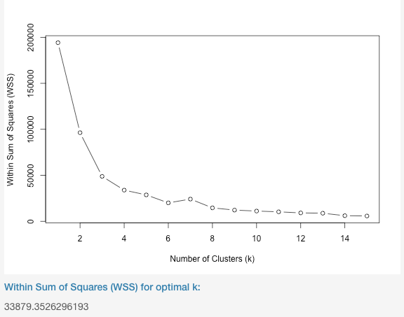
Figure: Elbow Plot of WSS vs. k clusters
Notes:
The elbow method involves fitting the model for a range of values for k and plotting the values of the cost function (inertia) associated with each value of k. The goal is to choose a small value of k that still has a low cost (inertia), yet a smaller k means fewer clusters, which is simpler and potentially more interpretable.
We fit the model with k values ranging from 1 to 15 and plot the cost function values, a steep decline in the cost function is observed from k=1 to k=4, a slower decline from k=4 to k=6, and an even slower decline from k=6 to k=15. In this case, the elbow would be at k=4, indicating that 3 is the optimal number of clusters for the data.

Slide 19
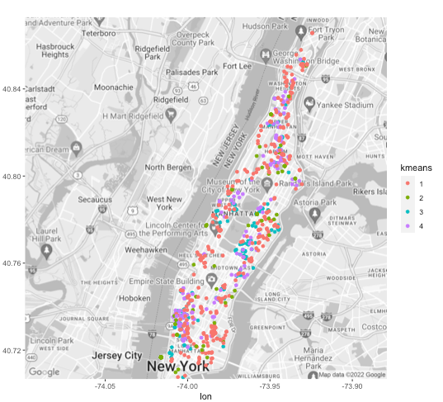
Cluster
Visualization
Figure: K-means clusters using sale price and gross square feet on the Manhattan map

Slide 20
Measurement of Uncertainty
Within Sum of Squares (WSS)
calculated by summing the squared distance between each data point and the cluster centroid (variance within a cluster)
Use: identify groups of data points that are more homogeneous yet distinct
smaller values indicating a better fit
Notes:
WSS
WSS Plot also called “Within Sum of Squares” helps to decide the value of K (number of clusters).
The values taken to plot the WSS plot will be the variance from each observation in the clusters to its centroid, summing up to obtain a value.
minimizing the sum of squares may be the primary objective of the clustering analysis, as it can help to identify groups of data points that are more homogenous and distinct from one another.
In k-means clustering, the goal is to minimize the within sum of squares by finding the optimal partition of the data into k clusters. The within sum of squares can be used as a measure of how well the clusters fit the data, with smaller values indicating a better fit. It is often used in conjunction with other measures, such as the silhouette score, to evaluate the quality of the clusters produced by a k-means clustering algorithm.

Slide 21
R SHINY APPLICATION
DEMO

Slide 22
"The future of real estate is being shaped by technology and innovation, and those who embrace it will be the ones who thrive in this changing landscape."
- Spencer Rascoff
Notes:
Data mapping and proptech tools such as the Manhattan Real Estate Tool can be valuable resources for real estate professionals, helping them to visualize and analyze data in a way that is meaningful and useful. By leveraging these tools, real estate professionals can make more informed decisions when advising clients on buying or selling properties, and can more effectively market properties to the right audience.

Slide 23

Thank you!
Happy Home Shopping!

Slide 24
References
Dangeti, P. (n.d.). Statistics for Machine Learning. O'Reilly Online Learning. Retrieved December 16, 2022, from https://www.oreilly.com/library/view/statistics-for-machine/9781788295758/c71ea970-0f3c-4973-8d3a-b09a7a6553c1.xhtml
Rashmi, Kassambara 06 May 2020 The demo data used in this tutorial is available in the default installation of R. Juste type data(“USArrests”) Reply, &amp; Kassambara. (2018, October 21). K-means clustering in R: Algorithm and practical examples. Datanovia. Retrieved December 16, 2022, from https://www.datanovia.com/en/lessons/k-means-clustering-in-r-algorith-and-practical-examples
Rolling Sales Data. (n.d.). Retrieved December 16, 2022, from https://www.nyc.gov/site/finance/taxes/property-rolling-sales-data.page
Shiny learning resources. Shiny. (n.d.). Retrieved December 16, 2022, from https://shiny.rstudio.com/tutorial/
Weighted Sum of Squares. Weighted sum of Squares. (n.d.). Retrieved December 16, 2022, from https://www.itl.nist.gov/div898/software/dataplot/refman2/auxillar/weigsmsq.htm

